Slide 1
TAMIL TEXT TO ENGLISH SPEECH CONVERSION
WITH UNL FOR TRANSLATION
Team
Jayavasanth R- 2011103562
Archana B - 2011103505
Siva MR - 2011103536
MENTOR:
Dr. RAJESWARI SRIDHAR

Slide 2
INTRODUCTION
UNL – Universal Networking Language is a declarative formal language specifically designed to represent semantic data extracted from natural language texts by the UNDL
It can be used as an interlingua for conversion from source language to target language.

Slide 3
Scope & Motivation
English has become a universal language of trade and communication. Hence it becomes necessary to translate regional languages to English
Official documents , school samacheer text books and even dialects in Tamil could be hereby voiced providing a great value.

Slide 4
ABSTRACT
Given a Tamil sentence as input, the project will translate it into its corresponding English sentence with no loss in meaning while preserving the semantic structure of English.
The translated sentence would be voiced over with a TTS Engine. Prosody would be added to each of these synthesized mechanical voices at signal level.
Given a batch of sentences ( document input ), each sentence would be processed and translated and synthesised into speech.

Slide 5
LITERATURE SURVEY
Paper Title and Authors | Concepts Discussed | Drawbacks
Morpho-Semantic Features for Rule-based Tamil Enconversion J Balaji , TV Geetha , Ranjani Parthasarathy, Madhan Karky | Forming UNL Graphs from tamil text 33 Rules for UNL Construction | No consideration about complex and compound Tamil Sentences
Semantic Parsing of Tamil Sentences Balaji J, Geetha T V, Ranjani Parthasarathi | UNL Nested graph identification | No indications about punctuations Precision <50%
A hybrid approach to construction of Wordnet Jayavasanth R , Rajeswari Sridhar | Graph wordnet database with holonyms , meronyms , hypernyms and morph forms . | No context based English equivalent analysis

Slide 6
LITERATURE SURVEY
Paper Title and Authors | Concepts Discussed | Drawbacks
POS Tagger and Chunker for Tamil Language Anand kumar, Dhanalakshmi, Rajendran, Soman | Tagging using Amrita tag set considering gramatic categories and features | Large number of tags in tag set increases complexity and reduces accuracy
A Novel approach to Morphological analysis for Tamil Sudhakar Sangeetha, Sekar Jothilakshmi | Romanization Segmentation Preprocessing

Slide 7
Paper Title and Authors | Concepts Discussed | Drawbacks
Flexibility, configurability and optimality in UNL deconversion via multiparadigm programming. Pelizzoni.J.M., Nunes.M.V. | Shortcomings of UNDL deconversion engine DeCo Proposal of an alternative deconversion model-MANATI Multi paradigm programming approach to specify an optimum- searching deconversion engine
Syllable based text to speech synthesis system using auto associative neural network prosody prediction Sudhakar Sangeetha, Sekar Jothilakshmi | Designing emotional content of a speech signal
LITERATURE SURVEY

Slide 8
Paper Title and Authors | Concepts Discussed | Drawbacks
The production and recognition of emotions in speech: features and algorithms. Pierre-Yves Oudeyer. | Calm , sadness , Anger , Comfort , Happiness Mel-frequency Ceptral component derivatives | Hasn’t considered other emotions Precision is less in this rule based approach
Emotions in the Voice: Humanising a robotic voice Tristan Bowles, Sandra Pauletto | Designing emotional content of a speech signal Modifying pitch , frequency and amplitude | Cannot distinguish happy and sadness

Slide 9
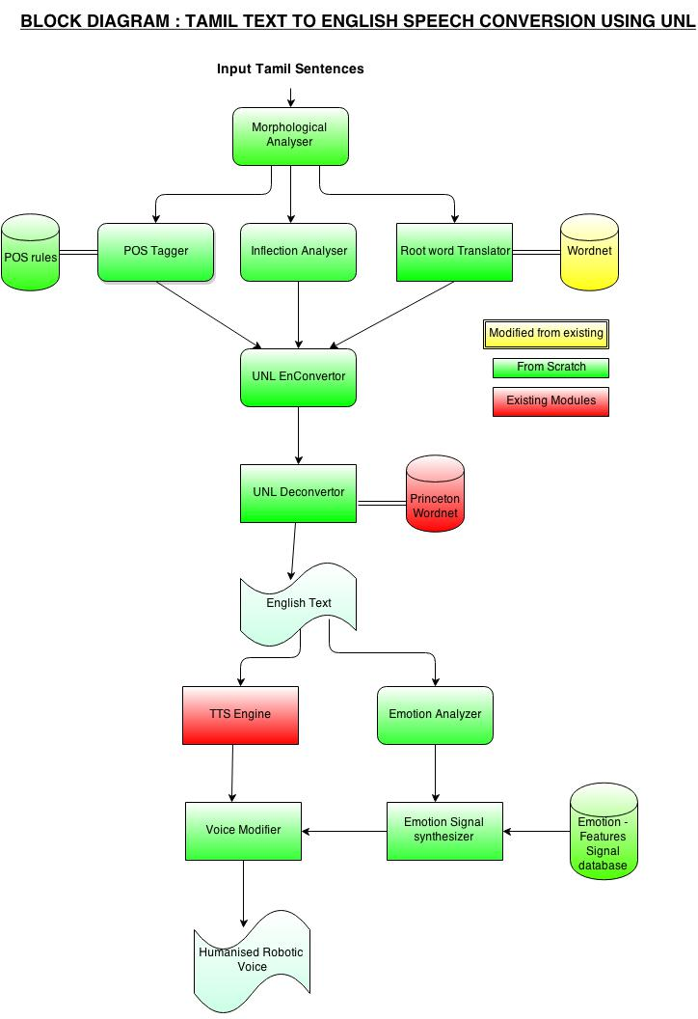
PROPOSED SYSTEM

Slide 10
MODULES
OFFLINE PHASE
Word Net Construction
Emotion – Features Signal Database
Construction
ONLINE PHASE
Morphological Analysis of Input
POS tagging
UNL En conversion
UNL Sub graph Identification
UNL De conversion
Emotion Identification
Voice Modification & Output

Slide 11
Word net Construction
Words from tamildict.com and an existing wordnet [3] are used for this.
Based on the POS of the English word from the Princeton database – the wordnet is organized.
A graph is used to represent the wordnet where in the root node will represent the tamil word and edges with values as noun , verb , adverb will point to nodes with respective english translation.

Slide 12
Emotion – Features Signal
Database Construction
Input
Voice corpus from English films are split according to emotion.
Feature extractor
Various features of speech like pitch , frequency, amplitude and few other MFCC components (mel-frequency ceptral components) are tabulated for each voice input.
The values of each of these parameters for each emotion is identified.

Slide 13
Morphological Analysis
of Tamil Sentences
Tamil is a morphologically rich language
A root word added to a number of inflections will form various other derived words
Only the root word is needed for translation
Thus the derived words are analyzed to split in to root word and inflections
Inflections give better information about the time and doer of the action.

Slide 14
POS Tagging
Tamil is partial free word order language
Hence the inflections are analysed to find the POS of a particular word
Inflections such as ‘ aye’ added to words , denote that they are objects in that sentence
Eg. Kaiyai pidathaan.
This information is needed for UNL graph construction

Slide 15
UNL Enconversion and
Subgraph Identification
Based on the root word and its POS the equivalent English word is decided
The tense is determined by the inflections
Using rules in the referred papers , the UNL graph is constructed
Based on punctuations and clause rules , the subgraphs are identified to be processed together

Slide 16
UNL DECONVERSION
Conversion from the UNL structural language to the final target language, i.e, English is called UNL deconversion.
Using the deconverter, UNL can then be converted to any language of our choice.
Deconversion is done with the help of princeton Word Net

Slide 17
EMOTION IDENTIFICATION
This phase involves the detection of emotion from the text.
The emotion features extracted from the text will be used for the prosody generation in the speech.

Slide 18
VOICE MODIFICATION
Achieved by varying parameters like pitch, amplitude, word speech rate of speech.
The rate of change of these parameters is decided by the emotion identified in previous slides
In general, sad and happy phrases have higher frequency and amplitude than sad phrases.

Slide 19
MODULES SPLIT UP
OFFLINE PHASE
Word Net Construction - Jayavasanth
Emotion-Signal Database - Archana
Construction
ONLINE PHASE
Morphological Analyzer - Siva
POS tagging - Siva
UNL En conversion - Jayavasanth
UNL Sub graph Identification - Jayavasanth
UNL De conversion - Archana
Emotion Identification - Archana
Voice Modification & Output - Siva

Slide 20
GANTT CHART

Slide 21
ISSUES
In Tamil words ‘aagupeyar‘ exists , where in a word may denote an another word indirectly , translation becomes difficult.
Our scope of translation of root words depends entirely on the Wordnet which puts a limit on the words that can be translated.
In UNL, it is possible to represent only 3 tenses (present, past and future) whereas in languages like English or Tamil there are several variations such as Continuous, Perfect Tenses etc. These cannot be expressed using UNL.
Prosody based on signal level is a complex approach and we are unsure of its efficiency.

Slide 22
REFERENCES
[1] Sudhakar Sangeetha, Sekar Jothilakshmi, “Syllable based text to speech synthesis system using auto associative neural network prosody prediction”, In International Journal of Speech Technology, Vol 17, Issue 2, pp 91-98.
[2] Tristan Bowles, Sandra Pauletto, (2010). “Emotions in the Voice: Humanising a Robotic Voice.” In: Proceedings of the 7th Sound and Music Computing Conference, Barcelona, Spain.
[3] Jayavasanth R ,Rajeswari Sridhar “A hybrid approach to construction of Wordnet ” In : INFITT -2014 , Pondicherry.
[4] Pierre-Yves Oudeyer , “The production and recognition of emotions in speech: features and algorithms” , In : Int. J. Human-Computer Studies 59 (2003) 157–183
[5] Anand Kumar M., Dhanalakshmi, Dr. S. Rajendran, Dr. K. P. Soman, “A Novel Approach to Morphological Analysis for Tamil”

Slide 23
REFERENCES
[6] Anand Kumar M., Dhanalakshmi, Dr. S. Rajendran, Dr. K. P. Soman, “POS Tagger and Chunker for Tamil Language”.
[7] J Balaji, T V Geetha, Ranjani Parthasarathi,
Madhan Karky, “Morpho-Semantic Features for Rule-based Tamil Enconversion”.
[8] Balaji J, Geetha T V, Ranjani Parthasarathi, “Semantic Parsing of Tamil Sentences”.
[9] Pelizzoni J M, Nunes M V “ Flexibility, Configurability and optimality in UNL deconversion via
multiparadigm programming. Universal Network Language: Advances in Theory and Applications”, 2005, Research on Computing Science: 175-194.

Slide 24
THANK YOU !

